Slide 1
REST & ASP.NET Web API
By @JefClaes

Slide 2
REST

Slide 3
The acronym
REpresentational State Transfer

Slide 4
REST is NOT...
‘Webservices using JSON’
A protocol
A design pattern

Slide 5
REST is...
“An architectural style for building distributed hypermedia systems.”

Slide 6
In theory...
REST isn’t limited
to a single message protocol.

Slide 7
But in practice...
It’s all about HTTP.

Slide 8
So now you wonder..
Haven’t we been successfully building
web services using SOAP and HTTP
for over 10 years ?

Slide 9
Basic Concepts

Slide 10

Resources
An entity, item, or just a thing you want to expose.
REST is Resource Oriented.
A bank
Notes:
Batbelt?

Slide 11
Identifiers
Something that identifies a resource.
BIC (= Bank Identifier Code): KREDBEBB
URI: http://myapi.com/bank/KREDBEBB

Slide 12
Representations
View on a resource’s state at an instant in time.
XML: <Bank>
<BIC>KREDBEBB</BIC>
<Name>KBC</Name>
</Bank>
JSON: {
"BIC":"123“,
“Name”:”KBC”
}
Other:
Images
CSV
Custom
...

Slide 13
Verbs
Actions on a resource.
Read, Update, Delete, Add
GET, PUT, DELETE, POST

Slide 14
Hypermedia
HATEOAS: Hypermedia as the engine of application state
Linking your API together

Slide 15
Architectural values
Architecture of the WEB

Slide 16
Scalability and performance
Yes, text-based, synchronous, request-response can be performant.
Stateless
Caching

Slide 17
Loose coupling
No transactions
No state
No guarantees
HATEOAS
No specific technology stack

Slide 18
Consistency and Uniformity
Everybody knows how to use HTTP
Constraints
Well understood semantics

Slide 19
Left-overs

Slide 20
Richardson’s Maturity Model
Level 0: POX Level 1: Resources Level 2: HTTP verbs
Level 3: Hypermedia

Slide 21
Questions?

Slide 22
ASP.NET WebAPI

Slide 23
What?
.NET (4.0) HTTP framework
for building RESTful services.

Slide 24
When?
HTTP Services (WCF)
AJAX back-ends

Slide 25
The server

Slide 26
Options
ASP.NET MVC
Click, click, click
SelfHost

Slide 27
Selfhost

Slide 28
Packages
Microsoft.AspNet.WebApi.SelfHost

Slide 29
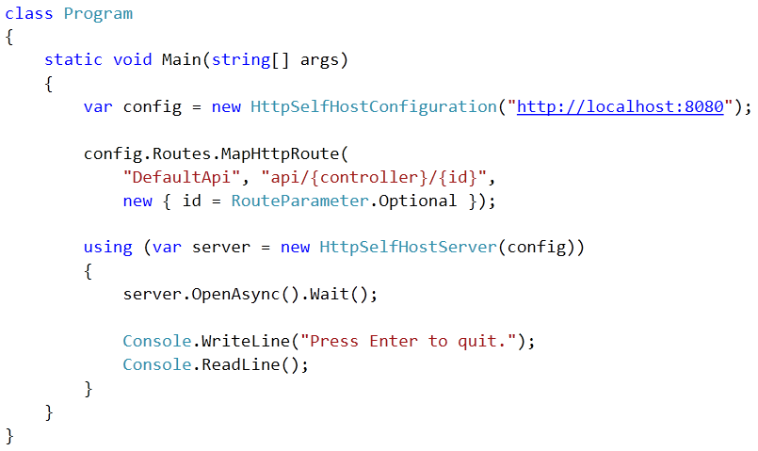
Starting

Slide 30
Simple CRUD

Slide 31
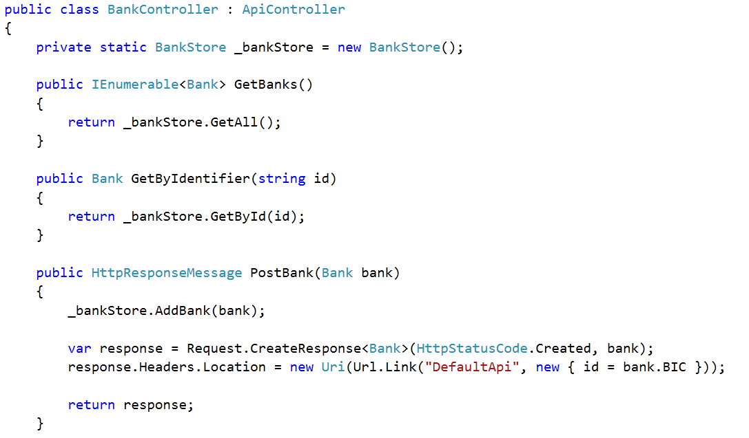
Creating a controller

Slide 32
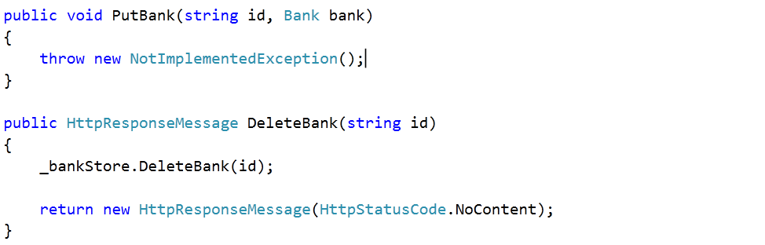
Creating a controller

Slide 33
Without conventions
Attributes [HttpGet]
[NonAction]

Slide 34
The Client

Slide 35
Packages
Microsoft.AspNet.WebApi.Client

Slide 36
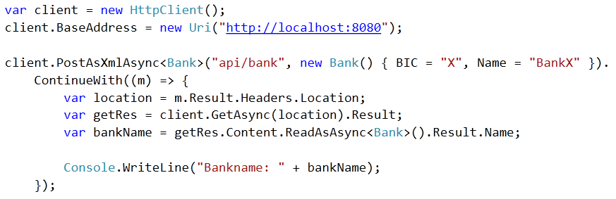
POST and GET

Slide 37
Exception handling

Slide 38
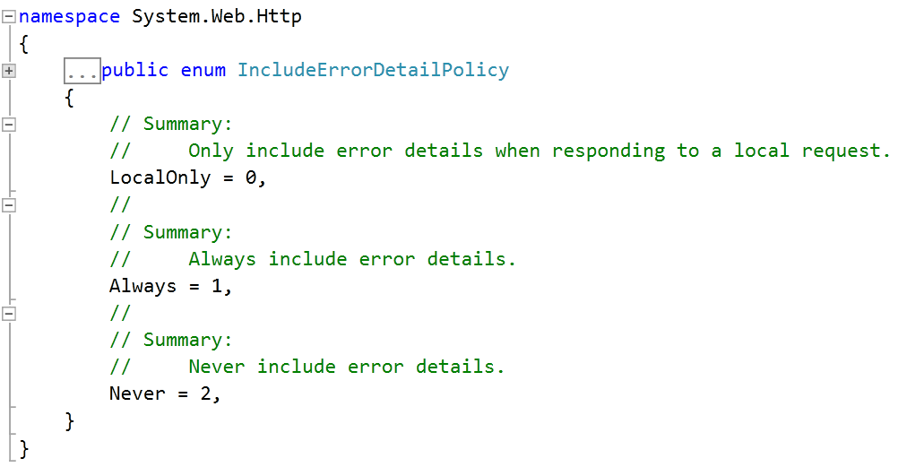
Default behaviour & IncludeErrorDetailPolicy
By default 500 Internal Server Error

Slide 39
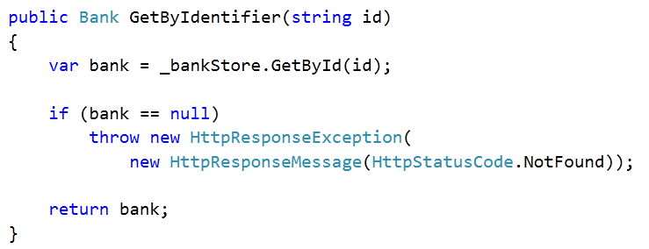
HttpResponseException

Slide 40
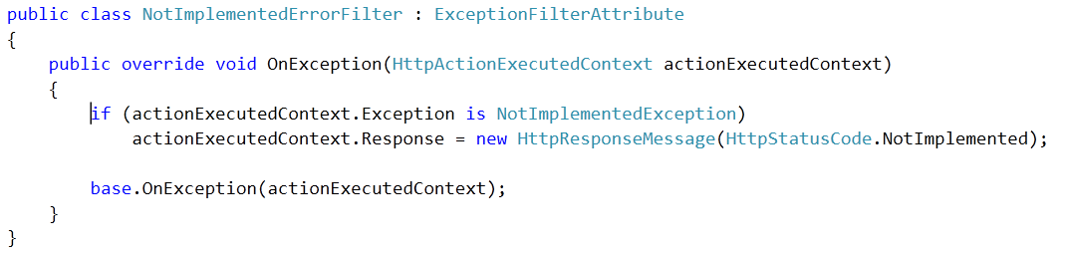
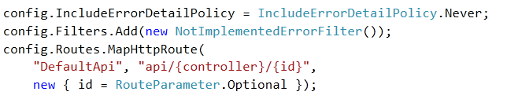
ErrorFilters

Slide 41
Content negotiation

Slide 42
XML/JSON
Supported out of the box:
text/xml
application/json (NewtonSoft)

Slide 43
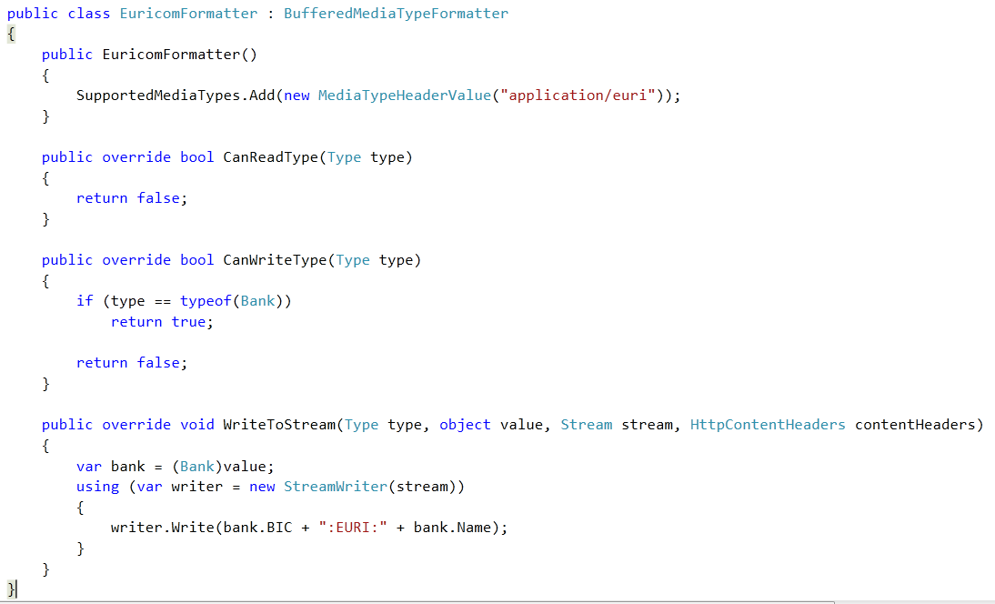
Custom formatters

Slide 44
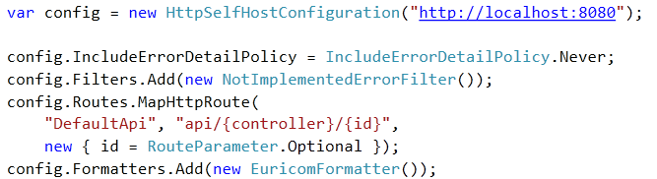
Custom formatters

Slide 45
HTTP Messagehandlers

Slide 46

HTTP intermediaries

Slide 47
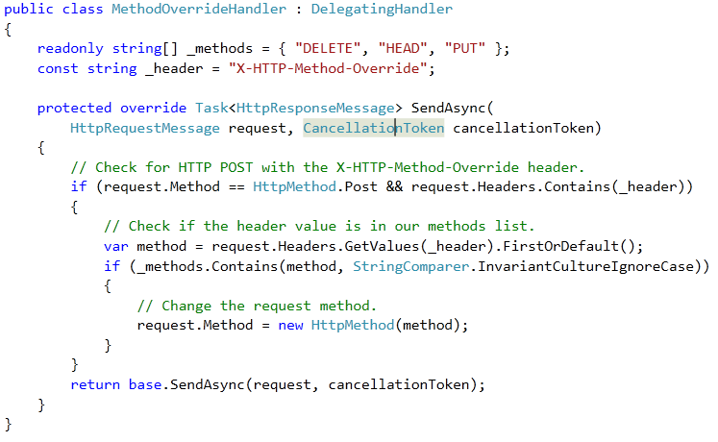
DelegatingHandler

Slide 48
DelegatingHandler

Slide 49
IoC

Slide 50
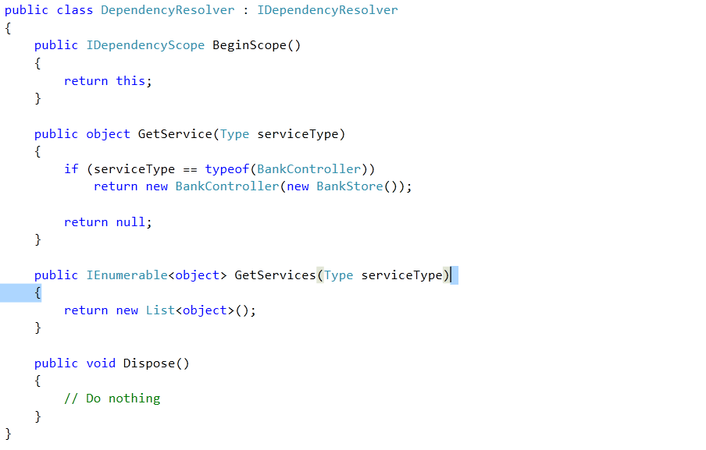
IDependencyResolver

Slide 51
IDependencyResolver

Slide 52
Testing

Slide 53
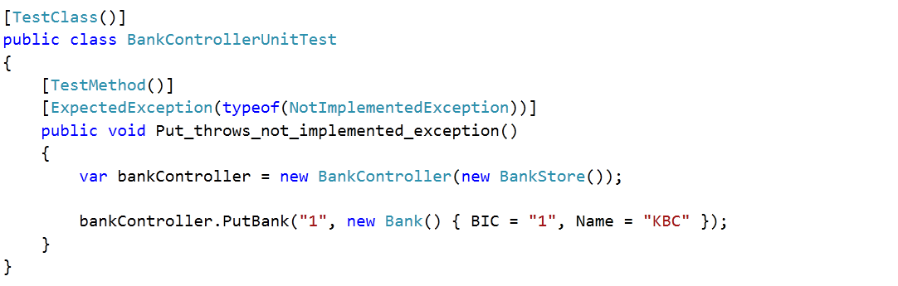
Unit testig

Slide 54
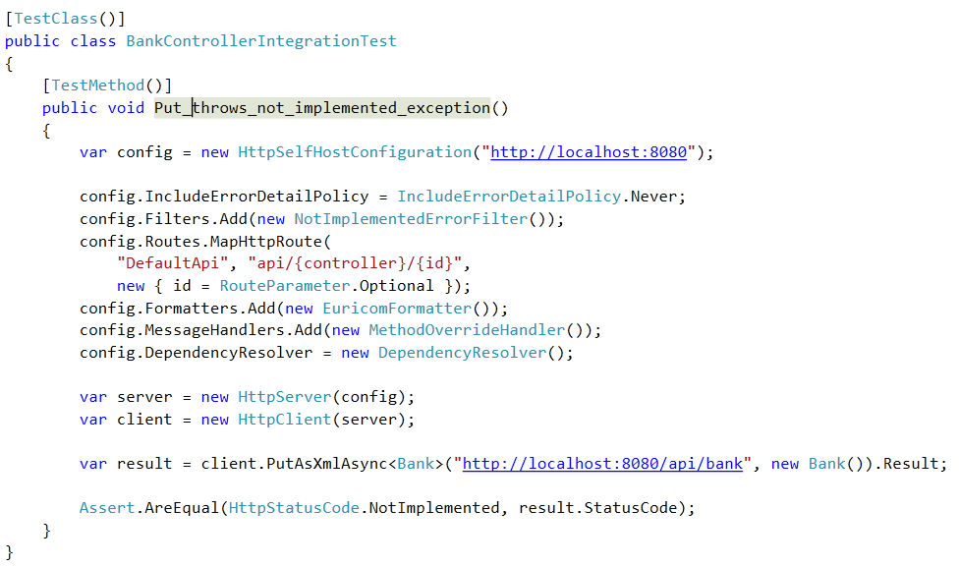
Integration testing in-memory

Slide 55
Summary
REST
Concepts
Architectual values
Left overs
ASP.NET Web API
Server/client
Exception handling
Content negotiation
Message handlers
IoC
Testing

Slide 56
Questions

